Slide 1
Banking Example
branch (branch-name, branch-city, assets)
customer (customer-name, customer-street, customer-only)
account (account-number, branch-name, balance)
loan (loan-number, branch-name, amount)
depositor (customer-name, account-number)
borrower (customer-name, loan-number)

Slide 2
Example Queries
Find all loans of over $1200
σ_{amount > 1200} (loan)
Find the loan number for each loan of an amount greater than
$1200
∏_{loan-number} (σ_{amount} _{> 1200} (loan))

Slide 3
Banking Example
branch (branch-name, branch-city, assets)
customer (customer-name, customer-street, customer-only)
account (account-number, branch-name, balance)
loan (loan-number, branch-name, amount)
depositor (customer-name, account-number)
borrower (customer-name, loan-number)

Slide 4
Example Queries
Find the names of all customers who have a loan, an account, or both, from the bank
∏_{customer-name} (borrower) ∪ ∏_{customer-name} (depositor)
Find the names of all customers who have a loan and an
account at bank.
∏_{customer-name} (borrower) ∩ ∏_{customer-name} (depositor)

Slide 5
Banking Example
branch (branch-name, branch-city, assets)
customer (customer-name, customer-street, customer-only)
account (account-number, branch-name, balance)
loan (loan-number, branch-name, amount)
depositor (customer-name, account-number)
borrower (customer-name, loan-number)

Slide 6
Example Queries
Find the names of all customers who have a loan at the Perryridge branch.
∏_{customer-name} (σ_{branch-name=“Perryridge”}
(σborrower.loan-number = loan.loan-number(borrower x loan)))
Find the names of all customers who have a loan at the Perryridge branch but do not have an account at any branch of the bank.
∏_{customer-name} (σ_{branch-name = “Perryridge”}
(σborrower.loan-number = loan.loan-number(borrower x loan))) – ∏_{customer-name}(depositor)

Slide 7
Example Queries
Find the names of all customers who have a loan at the Perryridge branch.
Query 1 ∏_{customer-name}(σ_{branch-name = “Perryridge”} ( σborrower.loan-number = loan.loan-number(borrower x loan)))
− Query 2
∏_{customer-name}(σloan.loan-number = borrower.loan-number( (σ_{branch-name = “Perryridge”}(loan)) x borrower))

Slide 8
Example Queries
Find the largest account balance
Rename account relation as d
The query is:
∏_{balance}(account) - ∏_{account.balance}
(σ_{account.balance < d.balance} (account x ρ_{d} (account)))

Slide 9
Example Queries
Find all customers who have an account from at least the “Downtown” and the Uptown” branches.
Query 1
∏_{CN}(σ_{BN=“Downtown”}(depositor account)) ∩
∏_{CN}(σ_{BN=“Uptown”}(depositor account))
where CN denotes customer-name and BN denotes branch-name.
Query 2
∏_{customer-name, branch-name} (depositor account) ÷ ρ_{temp(branch-name)} ({(“Downtown”), (“Uptown”)})

Slide 10
Example Queries
Find all customers who have an account at all branches located in Brooklyn city.
∏_{customer-name, branch-name} (depositor account) ÷ ∏_{branch-name} (σ_{branch-city = “Brooklyn”} (branch))

Slide 11
Banking Example
branch (branch-name, branch-city, assets)
customer (customer-name, customer-street, customer-city)
account (account-number, branch-name, balance)
loan (loan-number, branch-name, amount)
depositor (customer-name, account-number)
borrower (customer-name, loan-number)

Slide 12
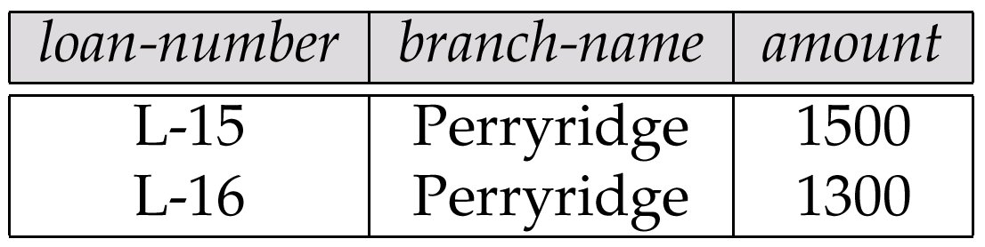
Result of σ _{branch-name = “Perryridge”} (loan)

Slide 13
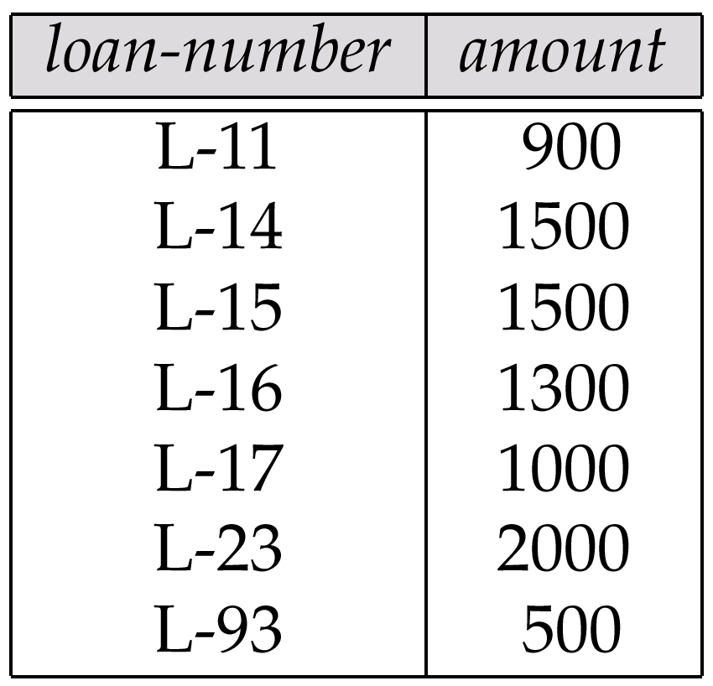
Loan Number and the Amount of the Loan

Slide 14
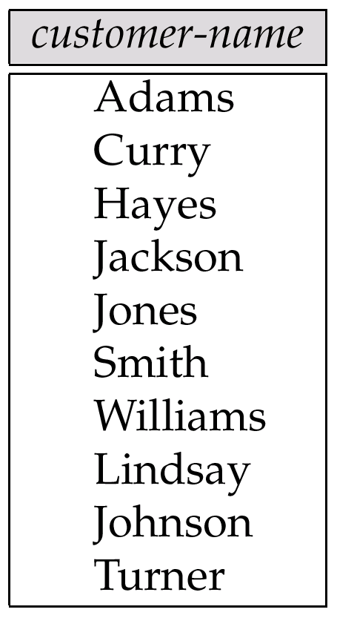
Names of All Customers Who Have Either a Loan or an Account

Slide 15
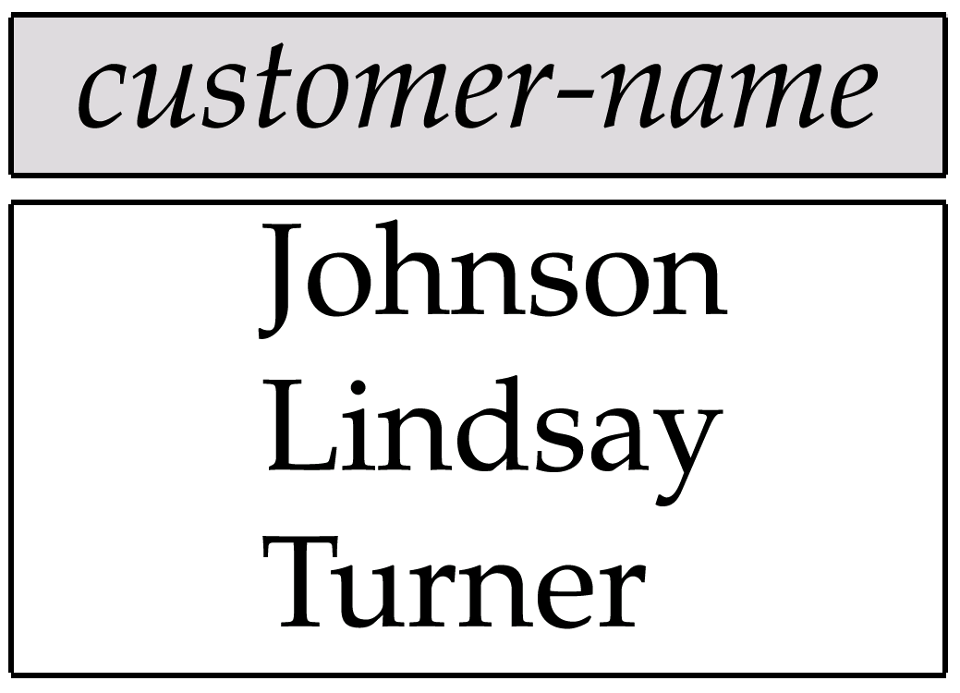
Customers With An Account But No Loan

Slide 16
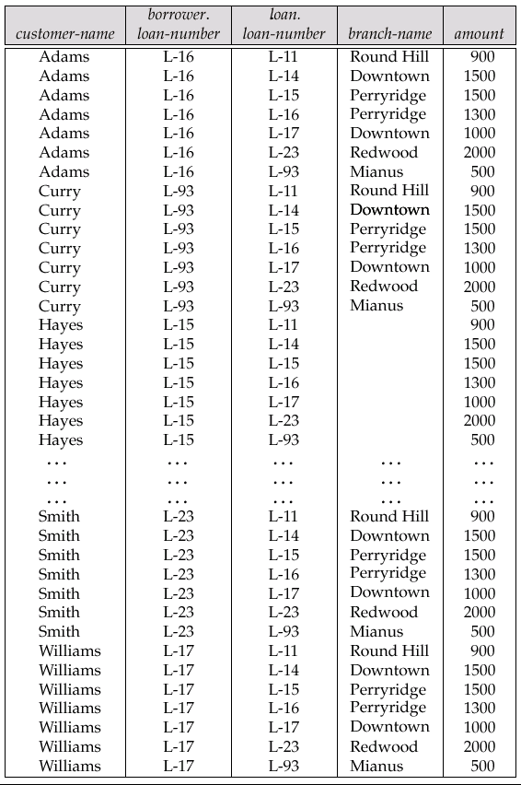
Result of borrower × loan

Slide 17
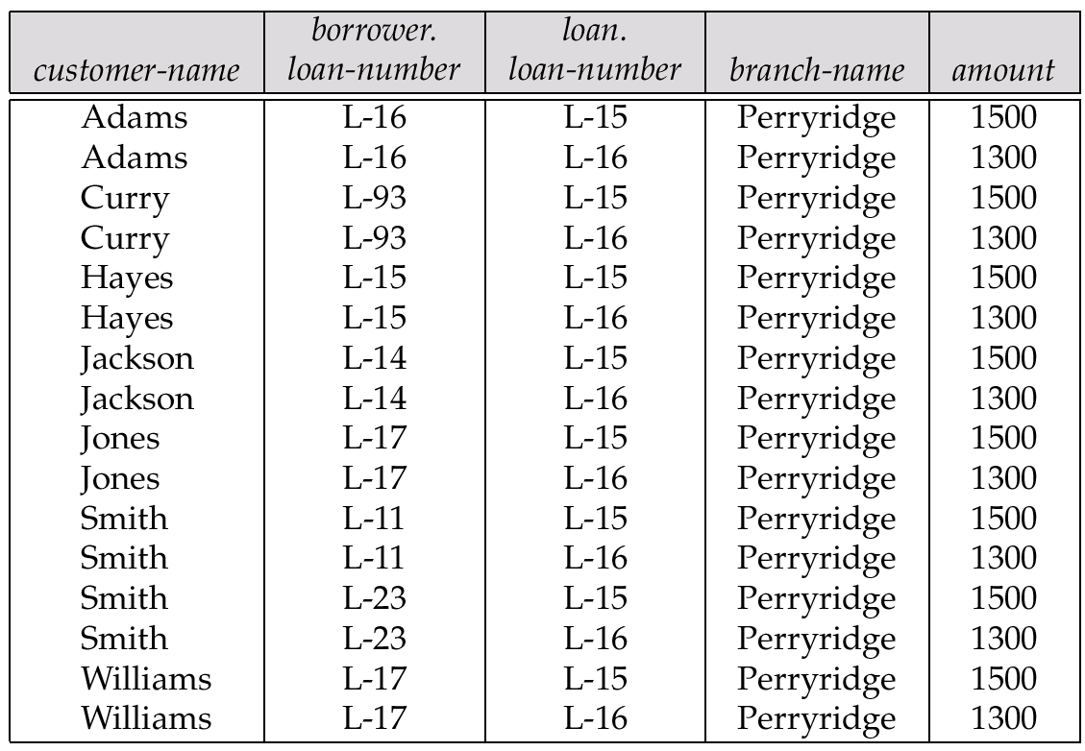
Result of σ _{branch-name = “Perryridge”} (borrower × loan)

Slide 18
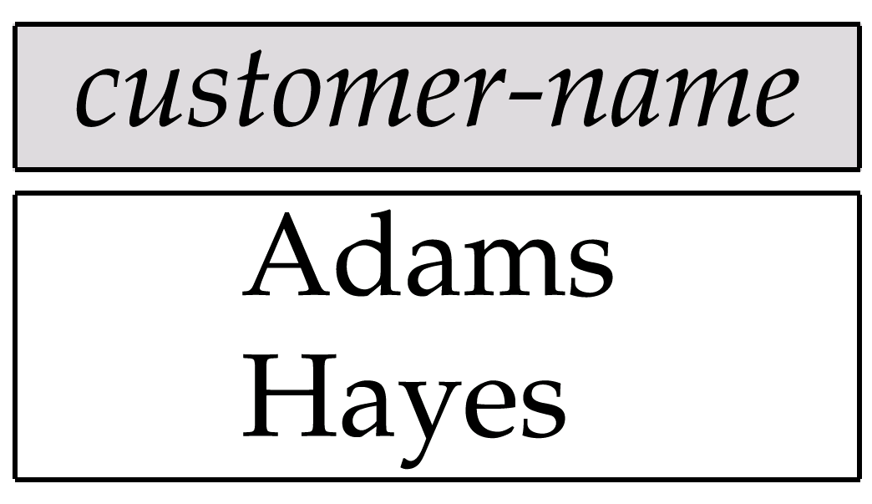
Result of Π_{customer-name}

Slide 19
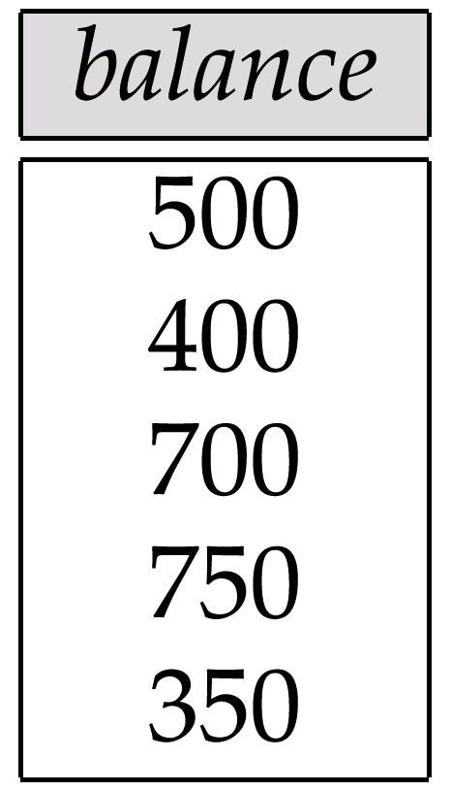
Result of the Subexpression

Slide 20
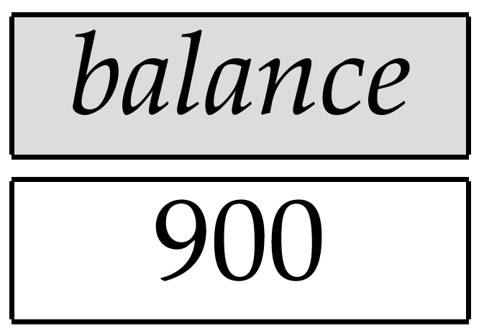
Largest Account Balance in the Bank

Slide 21
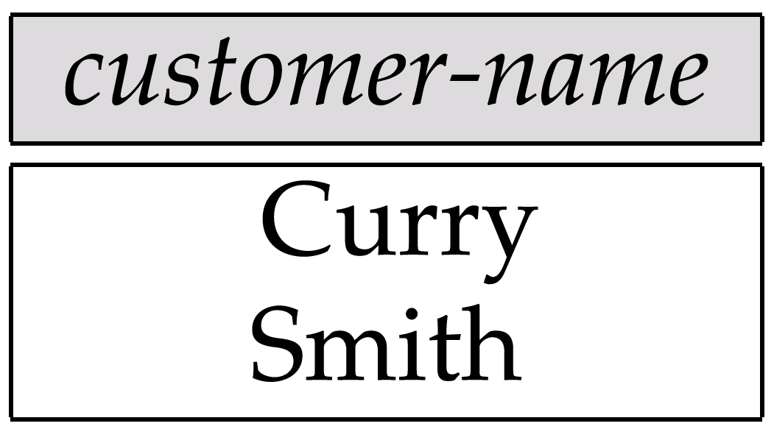
Customers Who Live on the Same Street and In the Same City as Smith

Slide 22
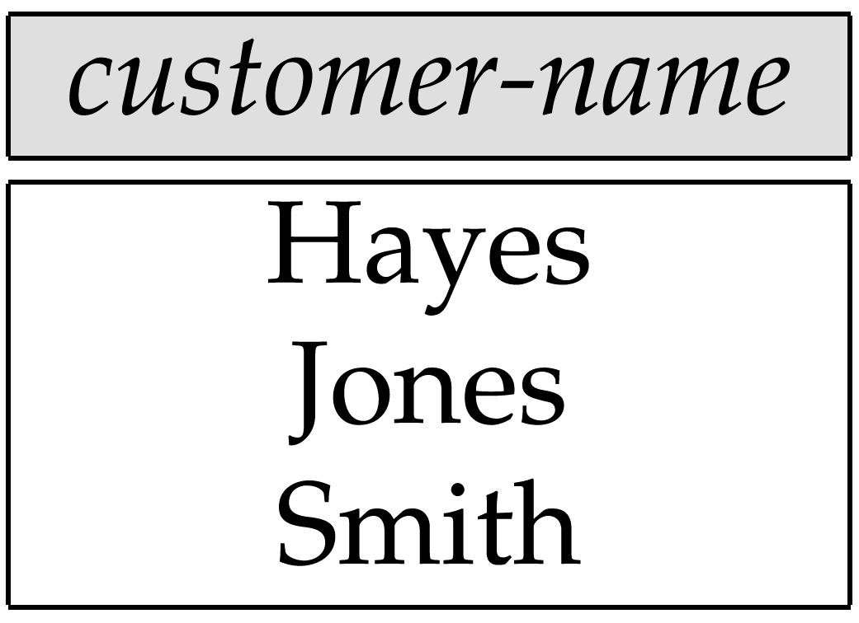
Customers With Both an Account and a Loan at the Bank

Slide 23
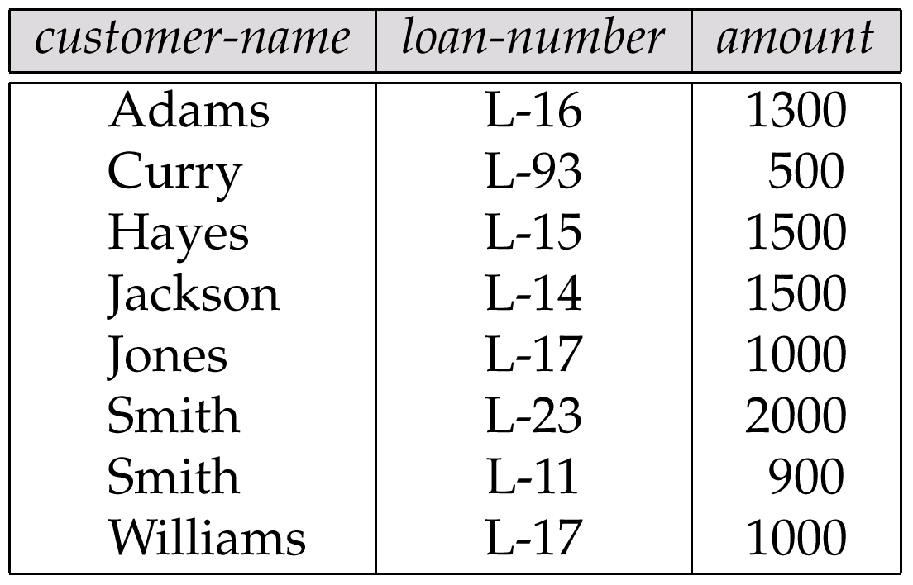
Result of Πcustomer-name, loan-number, amount (borrower loan)

Slide 24
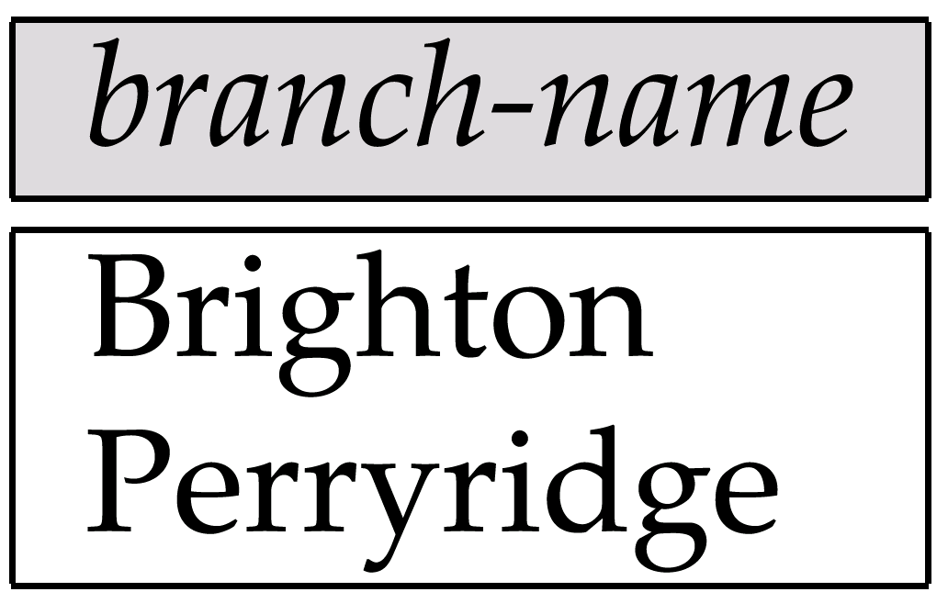
Result of Π_{branch-name}(σ_{customer-city = “Harrison”}(customer account depositor))

Slide 25
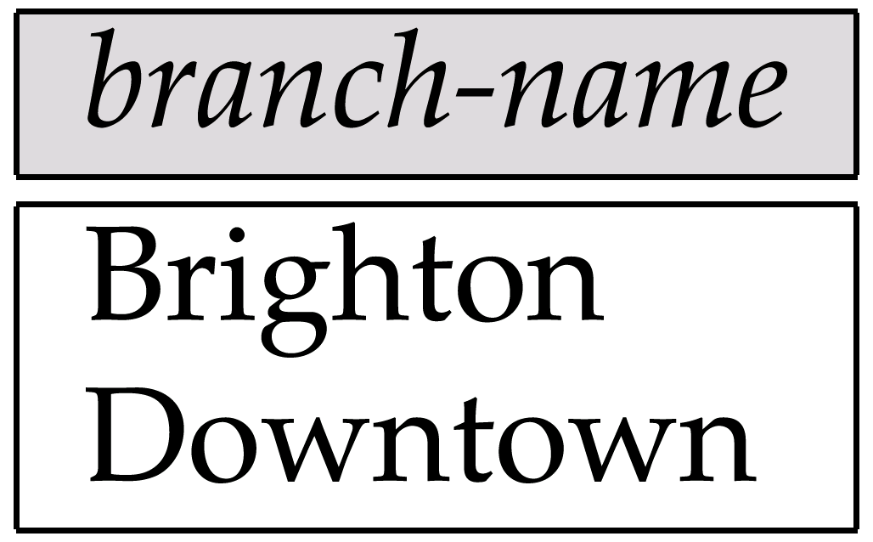
Result of Π_{branch-name}(σ_{branch-city =} “Brooklyn”^{(branch))}

Slide 26
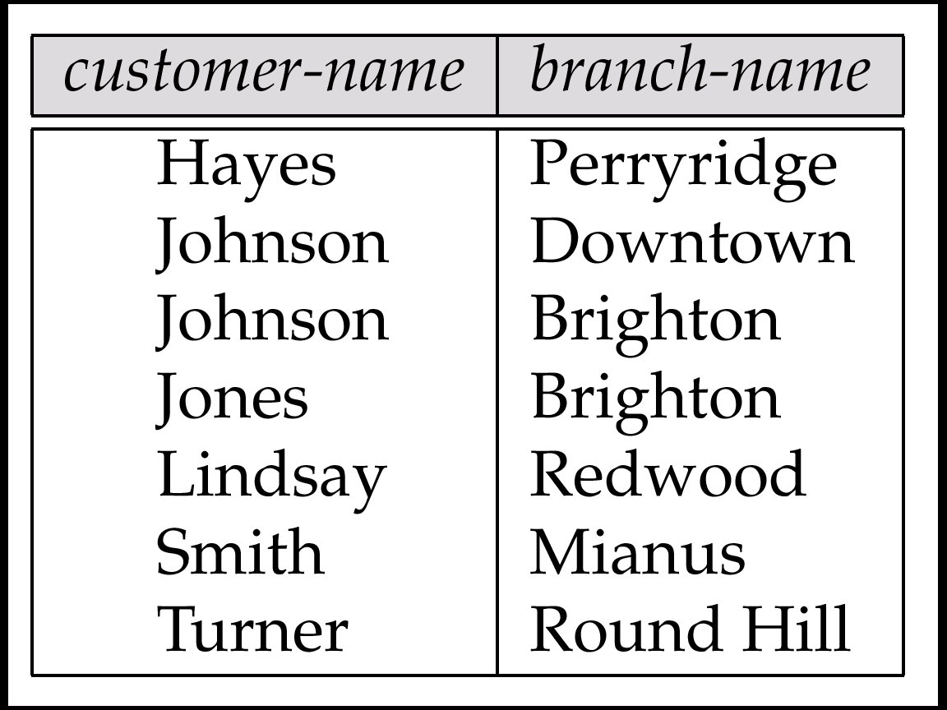
Result of Π_{customer-name, branch-name}(depositor account)

Slide 27
The credit-info Relation

Slide 28
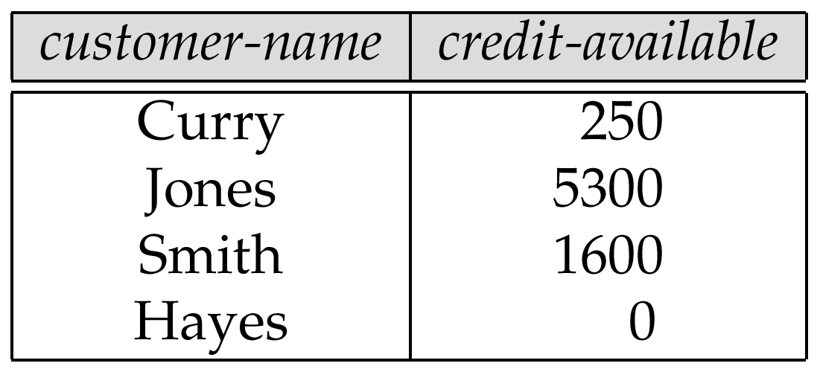
Result of Πcustomer-name, (limit – credit-balance) as credit-available(credit-info).

Slide 29
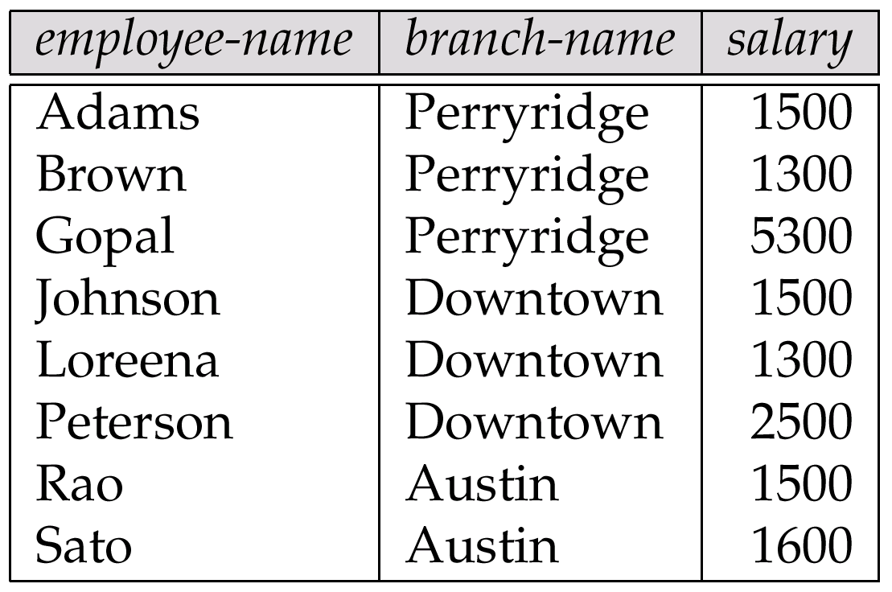
The pt-works Relation

Slide 30
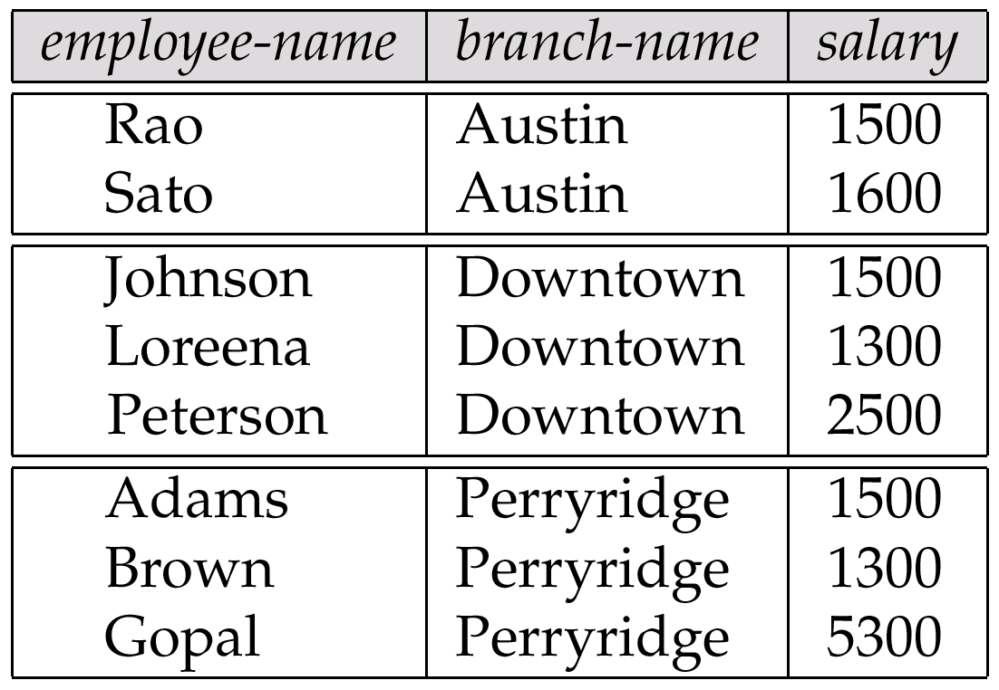
The pt-works Relation After Grouping

Slide 31
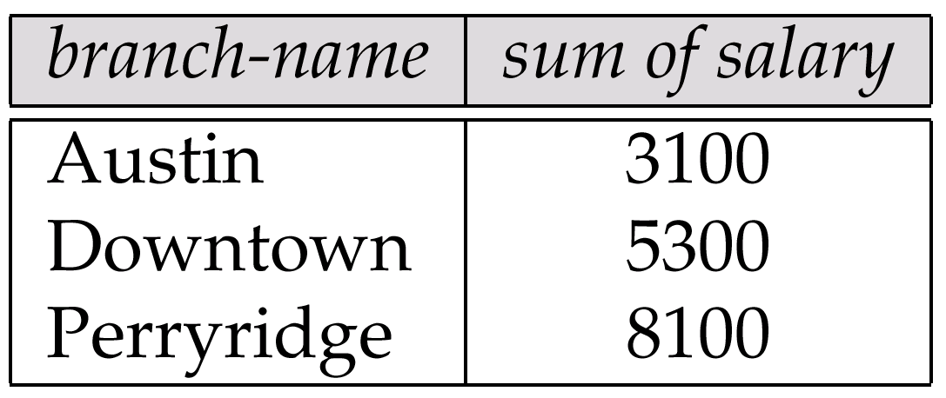
Result of _{branch-name} ς _{sum(salary)} (pt-works)

Slide 32
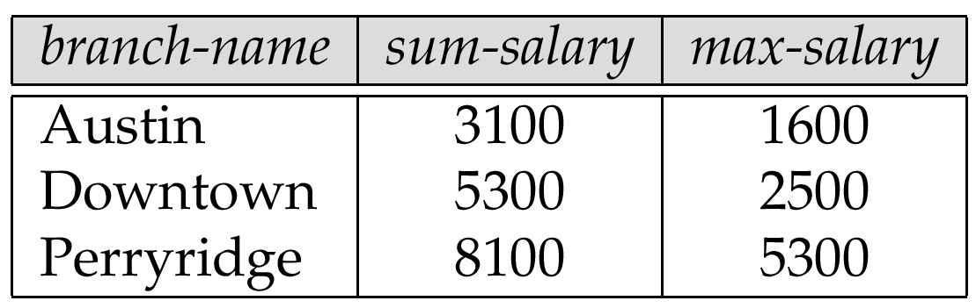
Result of _{branch-name} ς sum salary, max(salary) as max-salary (pt-works)

Slide 33
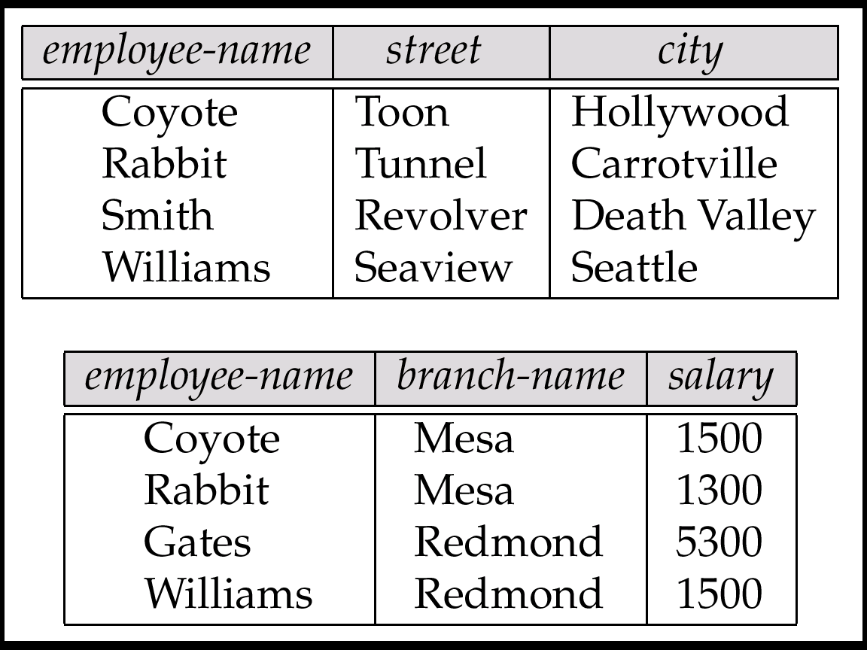
The employee and ft-works Relations

Slide 34
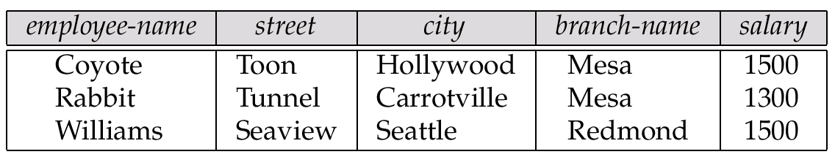
The Result of employee ft-works

Slide 35
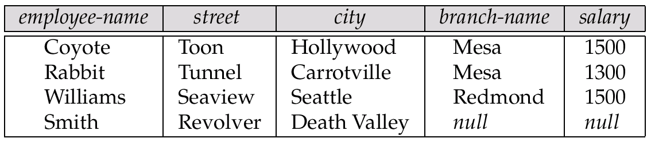
The Result of employee ft-works

Slide 36
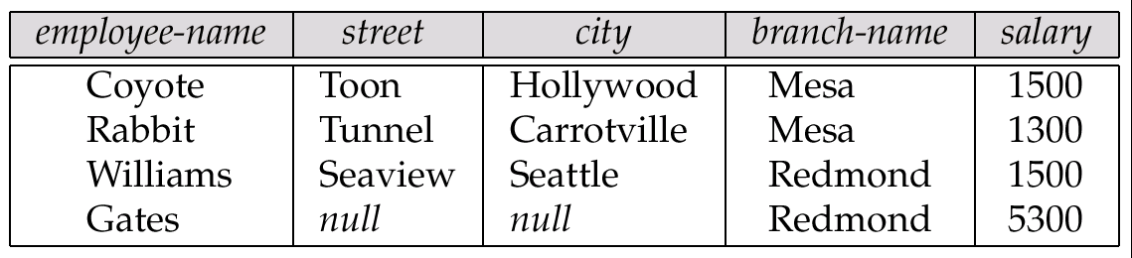
Result of employee ft-works

Slide 37
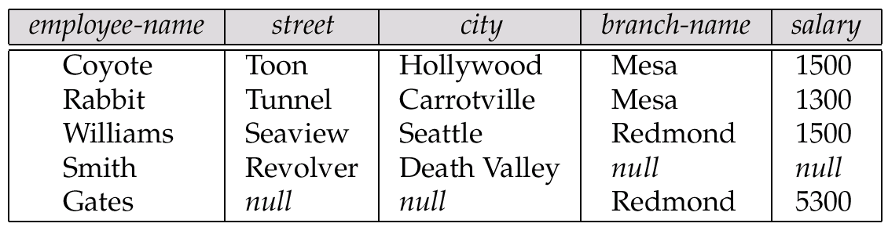
Result of employee ft-works

Slide 38
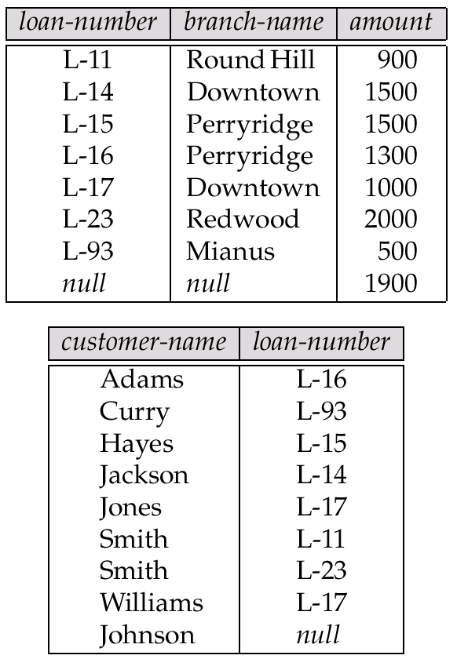
Tuples Inserted Into loan and borrower

Slide 39

Names of All Customers Who Have a Loan at the Perryridge Branch

Slide 40
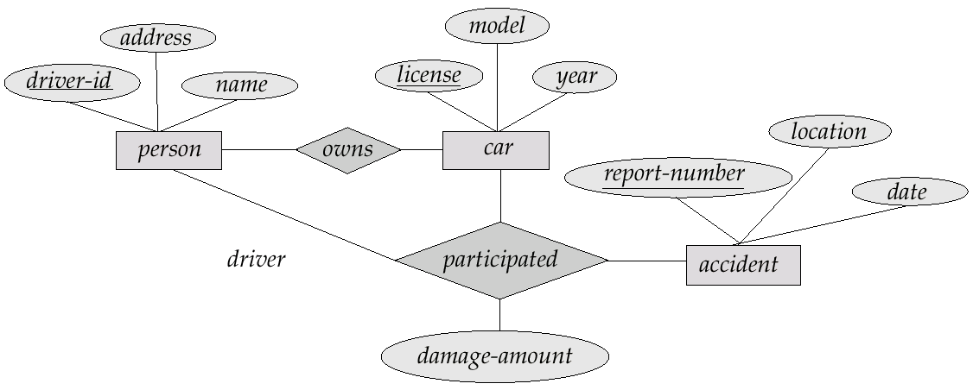
E-R Diagram

Slide 41
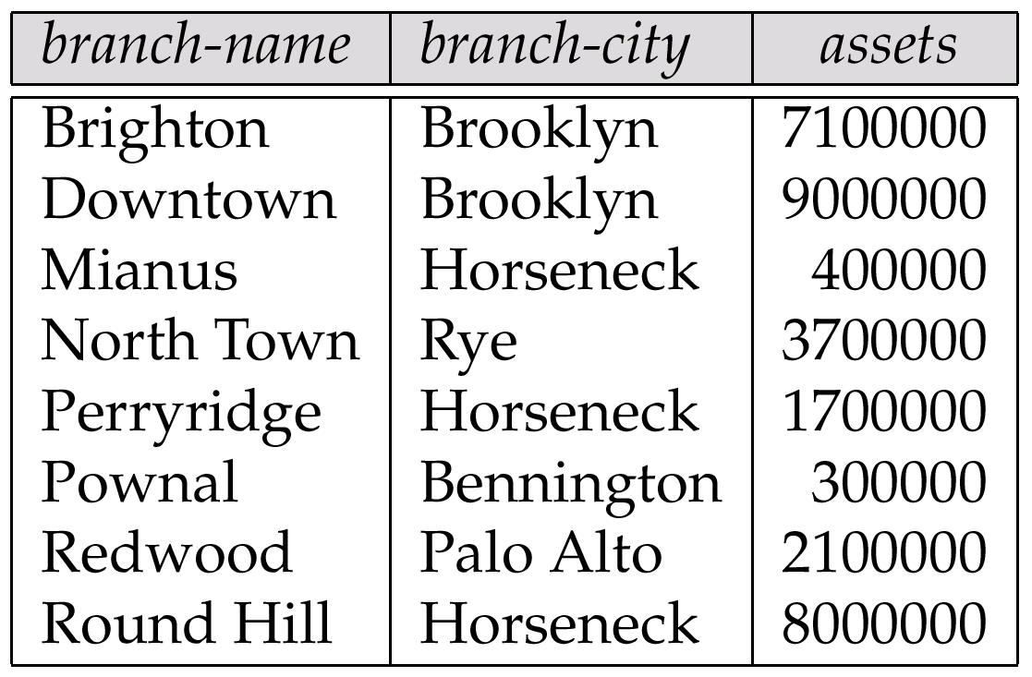
The branch Relation

Slide 42
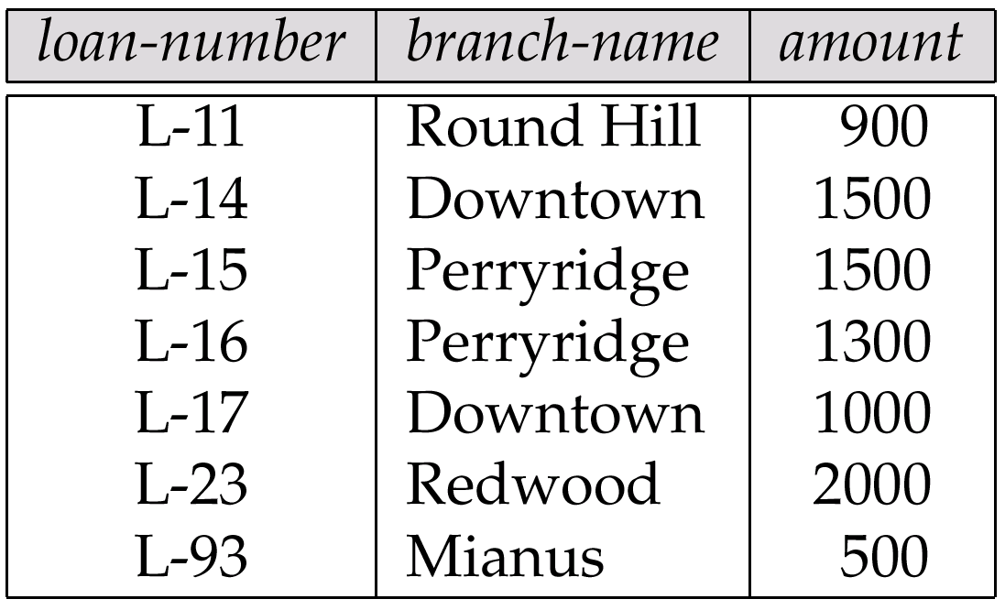
The loan Relation

Slide 43
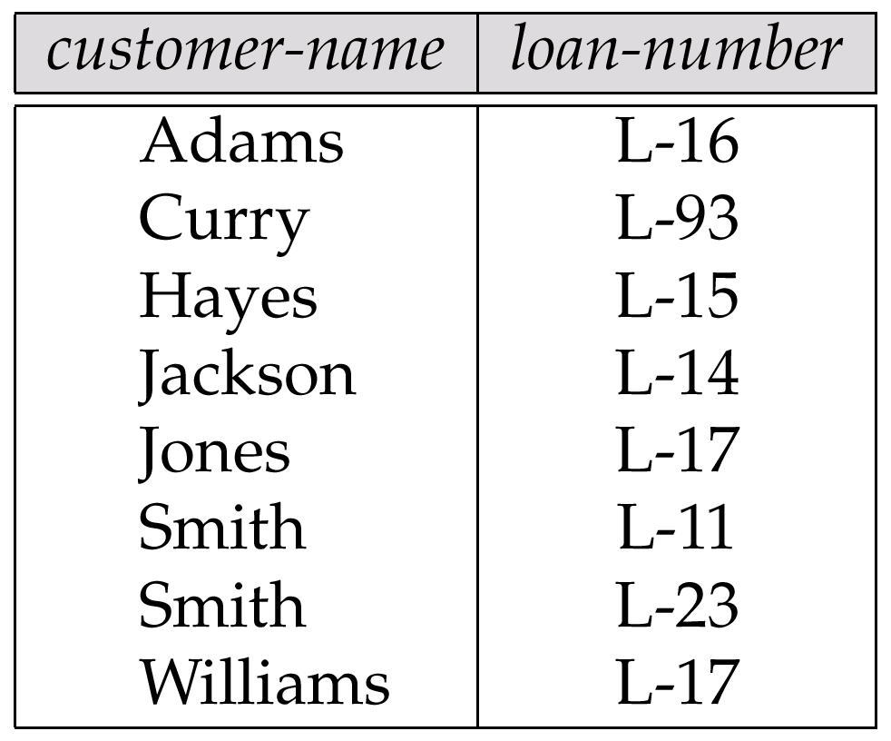
The borrower Relation

